Slide 1
Capstone Presentation
^{CHURN} ^{PREDICTION} ^{PROJECT} ^{Name - SHRADDHA SUMAN GURU} ^{Batch - JAN 22A}

Slide 2
CONTENTS
Business Problem Understanding
Data Report
Exploratory Data Analysis
Business Insights from EDA
Insights from k-NN Clustering
Model Building and Model Validation
Artificial Neural Network (ANN) Model
Implications on the business
Recommendation

Slide 3
Business Problem Understanding

Slide 4
Defining Problem Statement
An E Commerce company or DTH provider is facing a lot of competition in the current market and it has become a challenge to retain the existing customers in the current situation. Hence, the company wants to develop a model through which they can do churn prediction of the accounts and provide segmented offers to the potential churners.

Slide 5

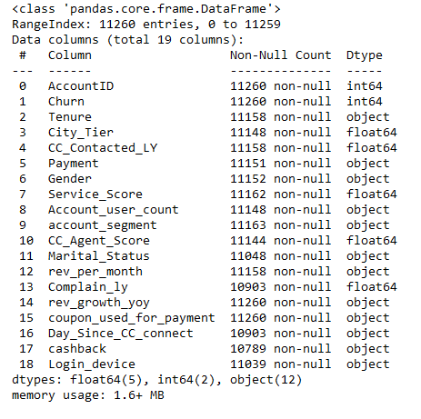
Data Report
Info of the dataset

Slide 6
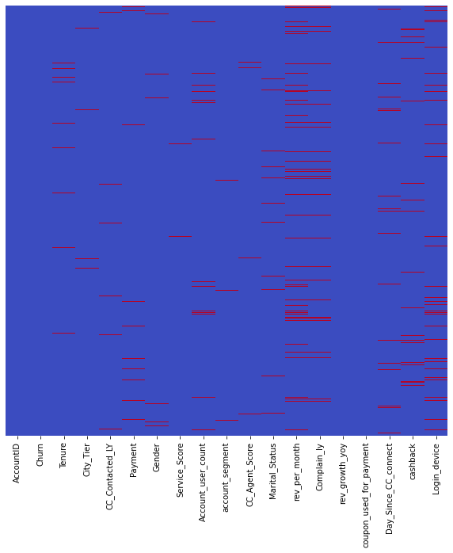
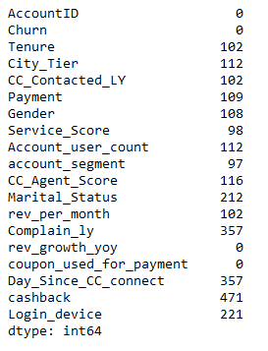
Null Values Visualisation

Slide 7
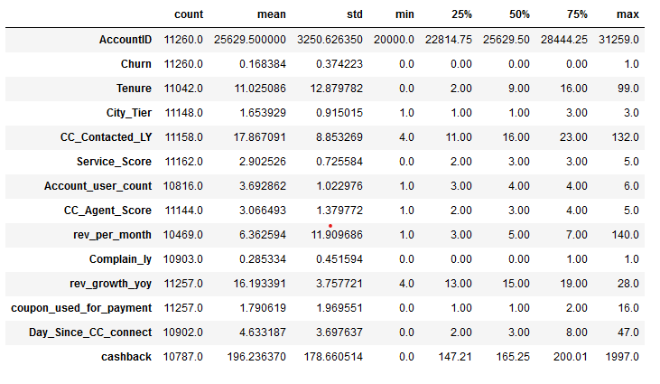
Description of the dataset

Slide 8
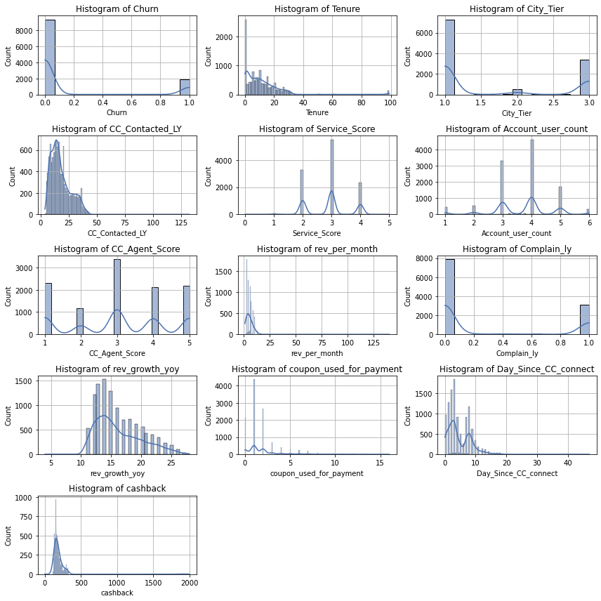
Exploratory Data Analysis
Histograms of the dataset

Slide 9
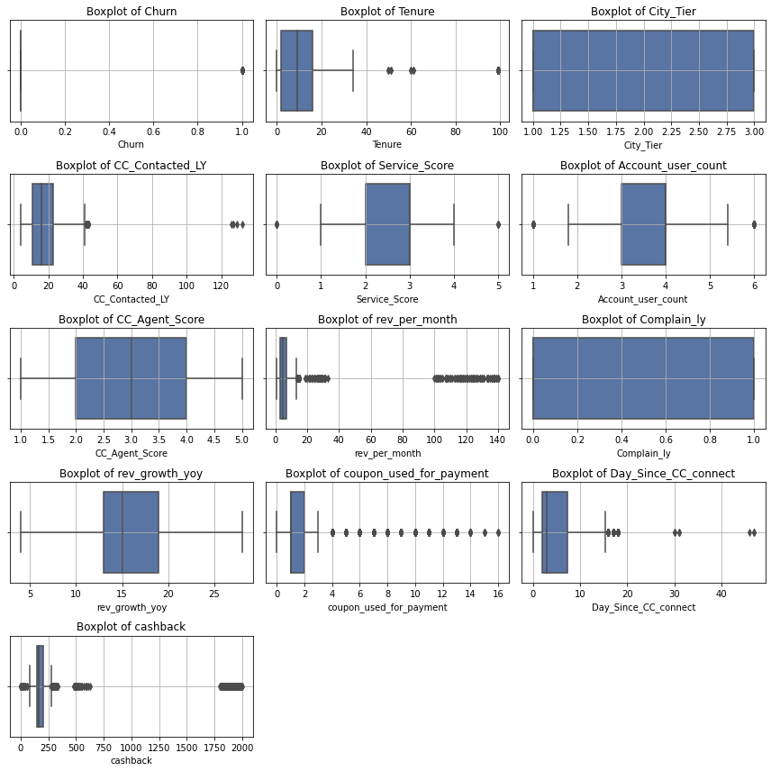
Box plots of the dataset

Slide 10
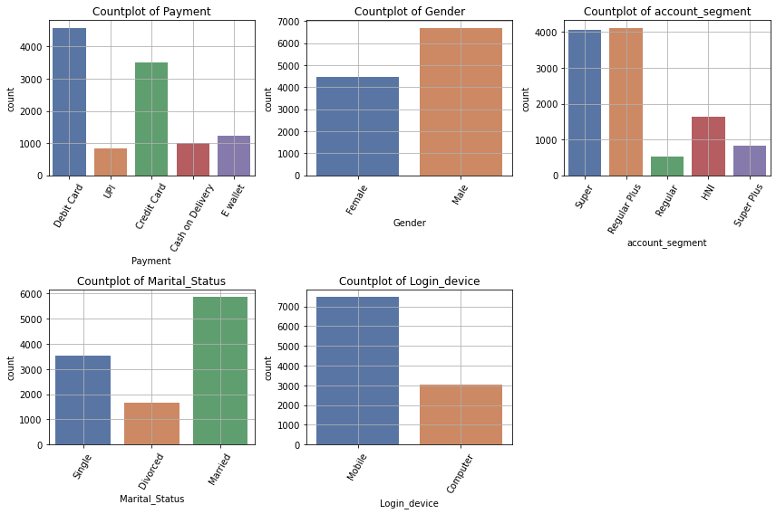
Count plots of the dataset

Slide 11
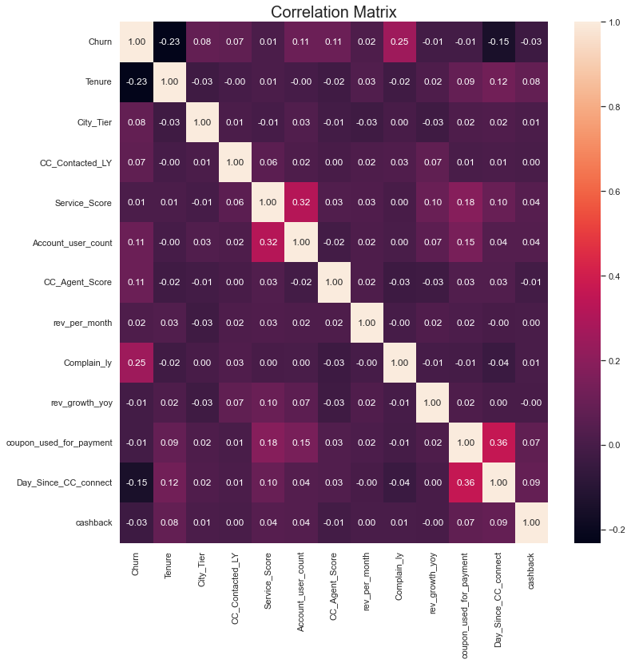
Correlation matrix

Slide 12
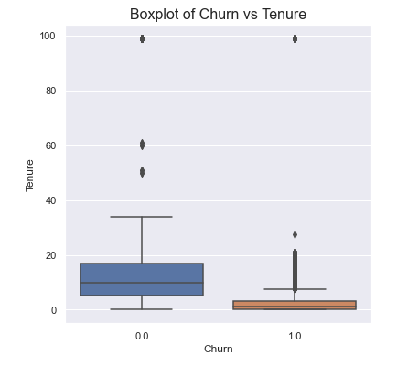
Box plot of Churn v/s Tenure

Slide 13
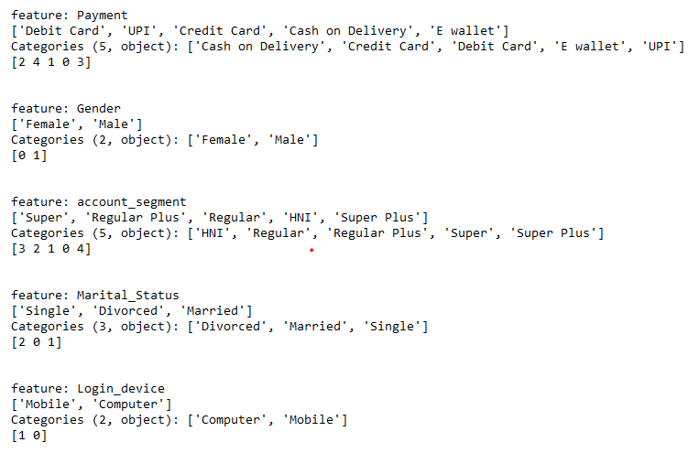
Variable Transformation

Slide 14
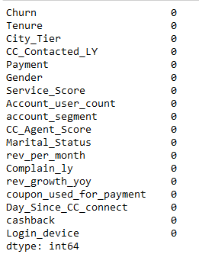
Imputing the null values

Slide 15
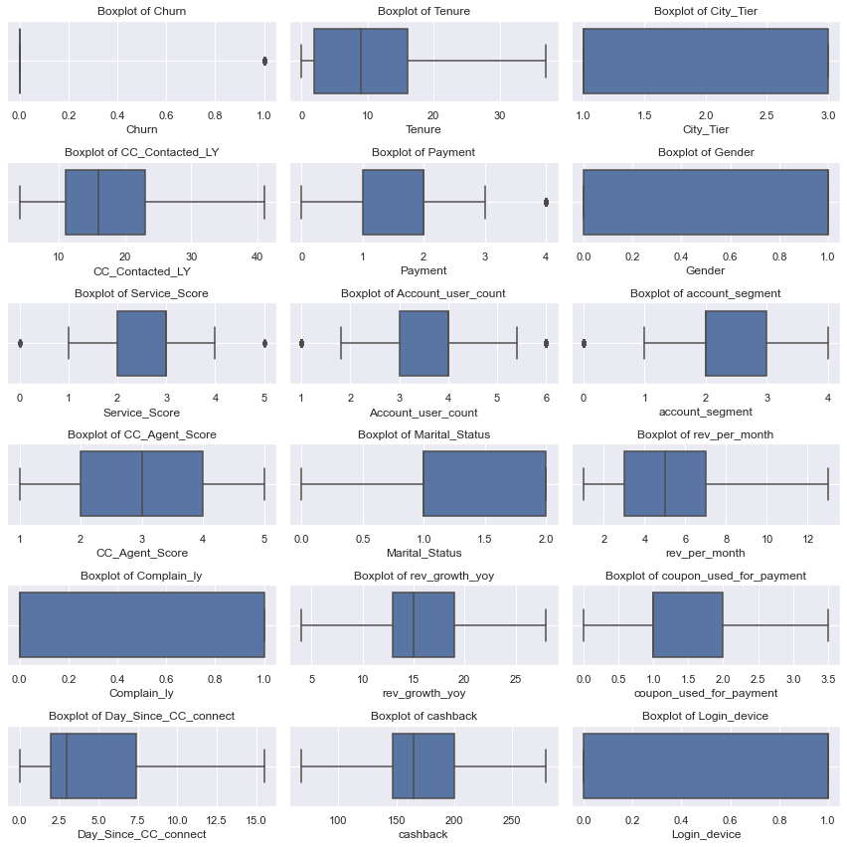
Treating the outliers

Slide 16
Business Insights from EDA
Married couples visit to buy the products; company should be able to provide products to both males and females i.e. fulfilling needs of the customers.
We can recommend the company to hire experienced trainees who can help in churn control.
Company should provide basic info of how to deal with customers to employees having low tenure.
Company should not spend all of their time and value retaining customers on the verge of being churned; Such customers are five times less than regular customers.

Slide 17
Insights from k-NN Clustering
3 segments from Clustering
Segment 1 (Mean Values) :- Tenure- 11 years, revenue (per month)–-5.57 L, Cash back- Rs. 188, Days since no customer contacted CC – 5 days
Segment 2 (Mean Values) :- Tenure– 18 years, revenue (per month)– 6.08 L, Cash back– Rs. 263, Days since no customer contacted CC – 7 days
Segment 3 (Mean Values) :- Tenure– 7 years, revenue (per month)– 4.83 L, Cash back– Rs. 144, Days since no customer contacted CC – 4 days

Slide 18
Model Building and
Model Validation

Slide 19


Artificial Neural Network (ANN) Model
Cross Validation Table
Best parameters

Slide 20
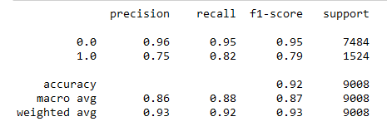
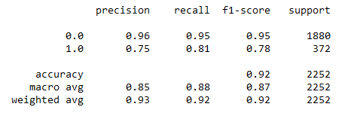
Classification Report
(Train)
(Test)

Slide 21
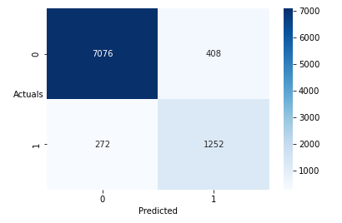
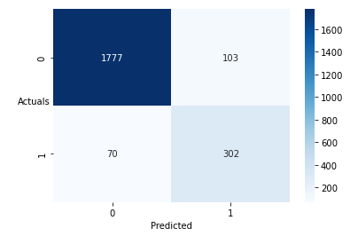
Confusion Matrix
Train
Test

Slide 22
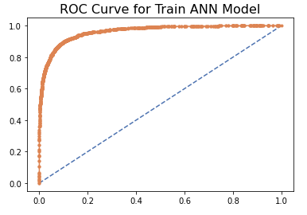
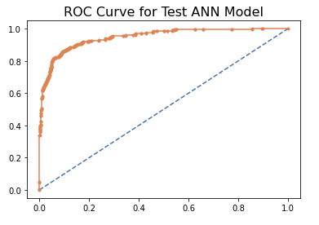
ROC Curve

Slide 23
Implications on the business
A good recall value implies retention of customers on the verge of being churned. If the recall is poor, it may lead to large loss and downfall of company.
Retention of customers will forge customer loyalty into the business.
This can also link a chance of attracting new customers into the business.

Slide 24
Recommendations
Company should provide a internship programme for the employees having low tenure.
Engage employees with profound knowledge and moderate or high tenure.
Company can provide discounts and lucrative combos to improve their sales.
Company can bring in new and diverse products to attract the attention of customers.

